Slide 1
智慧型管理決策系統
2016.11.30

Slide 2
Regression
Signal generator
F1(t) = 0.063 t³ – 5.284 t² + 4.887 t + 412 + noise
Problem settings
Input: a series of F1 signal with t = [1 100]
Prior knowledge: F1 is a linear equation of t
Goal: Reverse the original equation of F1(t)

Slide 3
Linear regression matlab code
f1 generator
function out = f1(t)
out = 0.063*t.^3-5.284*t.^2+4.887*t+412+randn(size(t))*10;
Input signal
Y = f1(1:100)';
X = [[1:100]'.^4 [1:100]'.^3 [1:100]'.^2 [1:100]' ones(100,1)];
Regression
B = regress(Y,X);
E = sqrt(sum((X*B-Y).^2)/length(Y));
plot(X*B);hold on;plot(Y,'R');

Slide 4
Non-linear cases
Signal generator
F2(t) = 0.6 t^{1.2} + 100 cos(0.4t) + noise;
Matlab implementation
function out = f2(t)
out = 0.6*t.^1.2+100*cos(0.4*t)+randn(size(t))*5;
Fitness function
function E= fitf2(Y,t,A,B,C,D)
E = sqrt(sum((A*t.^B+C*cos(D*t)-Y).^2)/length(Y));

Slide 5
Exhaustive Search
Suppose
A = -5.11 : 0.01 : 5.12
B = -5.11 : 0.01 : 5.12
C = -511 : 512
D = -5.11 : 0.01 : 5.112

Slide 6
Exhaustive Search
Experiment 1
Fix A,B,C to ground truth and estimate the fitness under different D settings
for i = 1 : 1024 E(i) = fitf2(Y,[1:100],0.6,1.2,100,-5.12+i*0.01); end
Plot the curve
plot(E)
Experiment 2
Fix B,D and estimate the fitness under different combination of A and C settings
for i = 1 : 1024 for j = 1 : 1024 E(i,j) = fitf2(Y,[1:100],-5.12+i*0.01,1.2,j-512,0.4); end end
Plot the surface
mesh(E);

Slide 7
Problem
Exhaustive Search
It requires 2⁴⁰ function calls
If the computational time of experiment 2 in previous slides is around 30 seconds, to examine 4 variables requires 364 days
Solution
Model the candidate solution and apply evolutionary algorithm, such as genetic algorithm, to find the optimal solution.

Slide 8
Genetic algorithm
定義基因
For example, 在我們的問題中使用一組40 bits code來代表4個變數
初代
利用亂數或expert knowledge產生一群初始的族群
複製 (reproduction)
計算fitness
利用fitness決定適者生存
輪盤式選擇 (roulette wheel selection)
依照fitness分割輪盤大小，面積比例越大越容易被選中
競爭式選擇 (tournament selection)
只留fitness最高的一小群人survive，淘汰適應不佳的

Slide 9
Genetic algorithm
交配 (crossover)
單點交配
此點以後的基因互換
雙點交配
兩點間的基因互換
遮罩交配
產生一個0/1 mask或filter，mask為1的bit互換
突變
少數bit 0->1或1->0

Slide 10
Exercise
2016.11.30

Slide 11
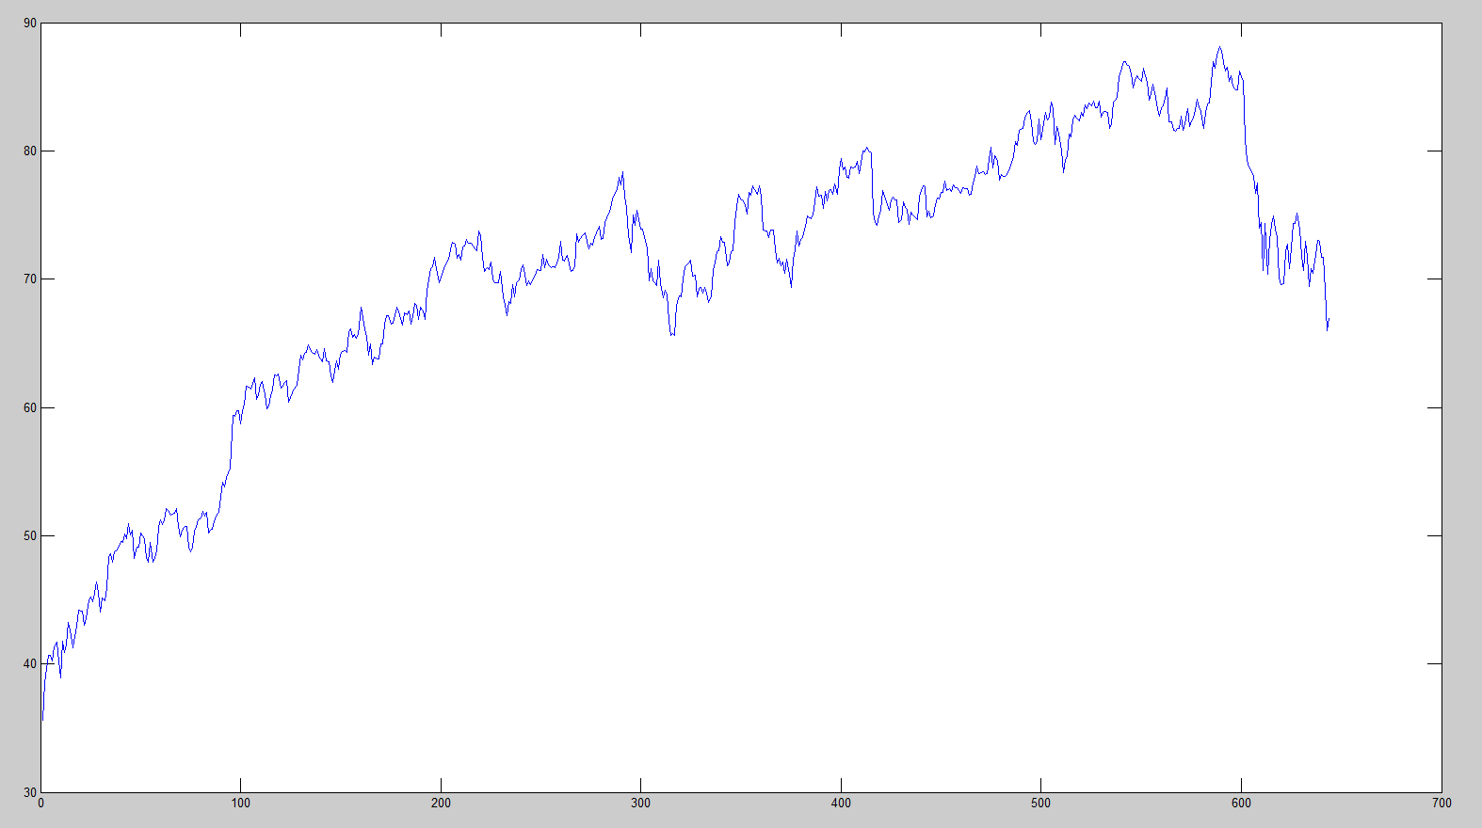
Financial Application (Bubble modeling)
The adjusted closing stock price of 3M Co.
2009/3/9 ~ 2011/9/23

Slide 12
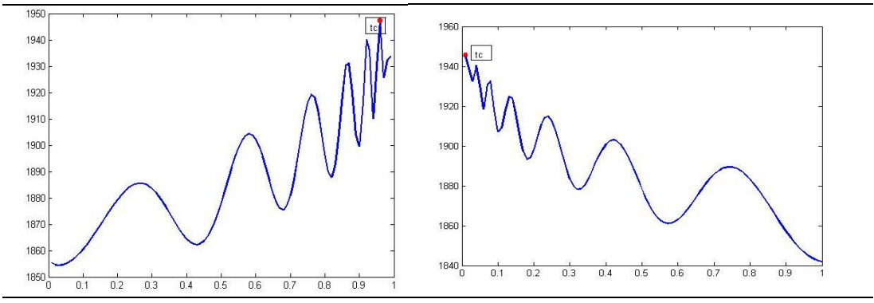
圖一 泡沫
圖二 反泡沫
資料來源：國泰君安證券研究所

Slide 13
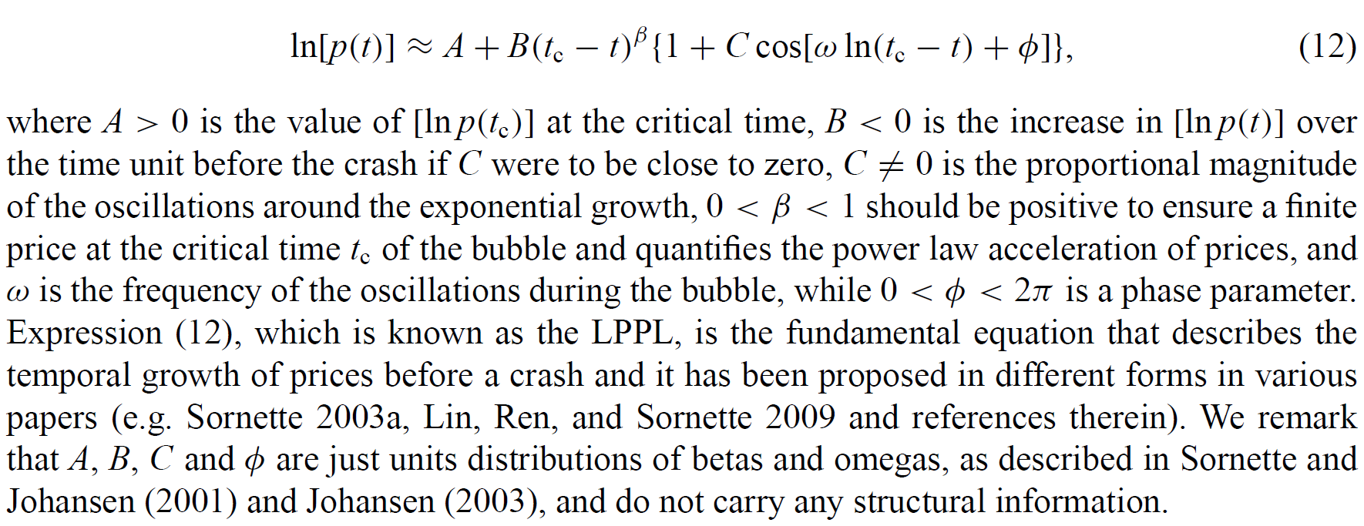
log-periodic power laws (LPPL) for bubble modeling

Slide 14
Implementation
LPPL function
function out = LPPL(A,B,C,tc,beta,w,phi)
out = A + B*((tc-[1:tc-1]).^beta).*(1+C*cos(w*log(tc-[1:tc-1])+phi));
plot(LPPL(log(8500),-0.1,0.01,600,0.01,10,pi))

Slide 15
Two step algorithm
Each gene includes 4 non-linear variables t_{c}, β, ω, Φ
Use linear regression to estimate best A, B, C
Try to find optimal solution by genetic algorithm to minimize the error between synthetic signals and real financial time-series data

